Slide 1
Software Analysis at Philips Healthcare
MSc Project Matthijs Wessels
01/09/2009 – 01/05/2010
Notes:
Intro presentatie, intro master project bij philips

Slide 2
Content
Introduction
Philips
Problem description
Static analysis
Techniques
Survey results
Dynamic analysis
Desired data
Acquiring data
Visualizing data
Verification
Conclusion
Notes:
>>Volgende slide is organogram

Slide 3
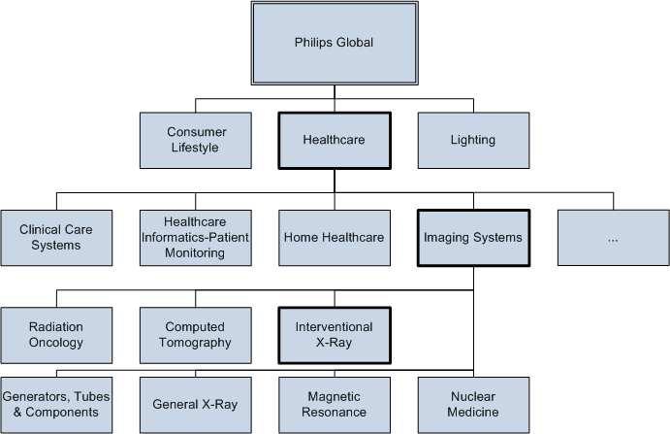
Organization
Notes:
>>Volgende slide apparaat

Slide 4
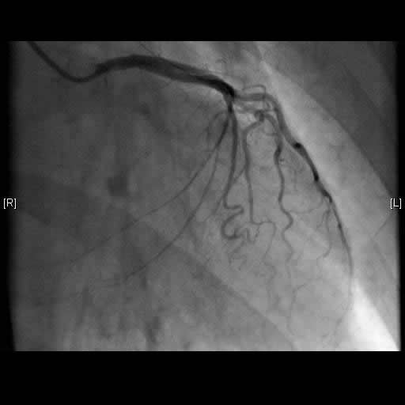
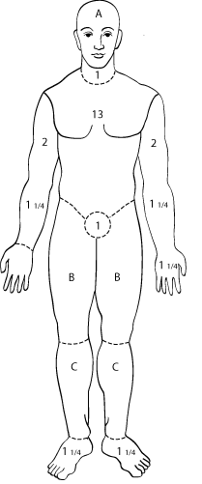
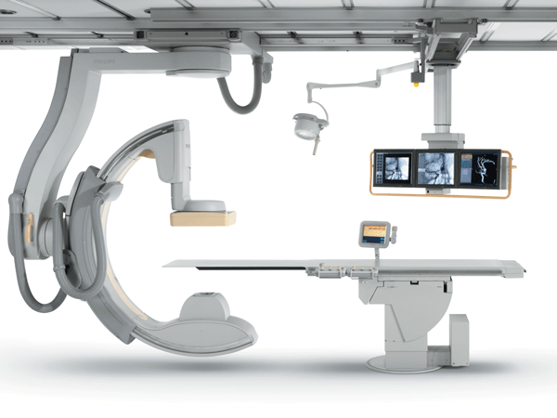
Minimum invasive surgery
Notes:
Click voor cardiovascular
Vetel over catheter door bloedvat
>> CXA

Slide 5
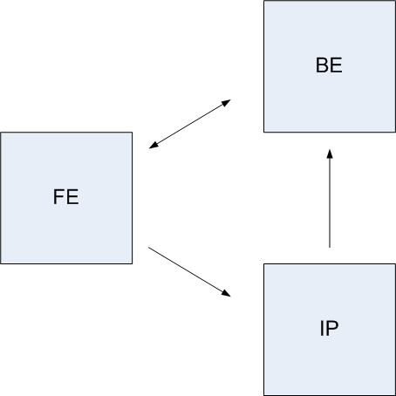

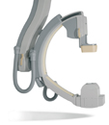
CXA Architecture
Notes:
>> Bex

Slide 6
BeX
Back-end X-ray
patient administration
connectivity to hospital information systems
graphical user interfaces
imaging applications
Based on PII
Notes:
>> PII

Slide 7
Philips Informatics Infrastructure
Goal
Allow re-use
Global look-and-feel
Before: Provide common components
Now: Provide almost-finished product
Notes:
>> Design PII

Slide 8
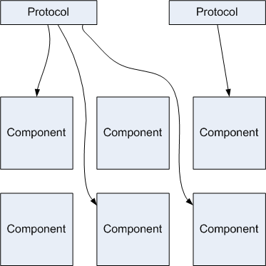
Design PII
Components
Building blocks
Well defined interfaces
Protocol
XML file
Connects components
through their interfaces
Notes:
>> Design BeX

Slide 9
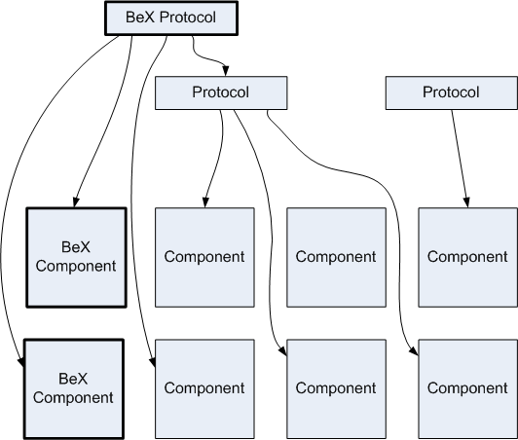
Design BeX
Build on PII
Notes:
>> Units

Slide 10
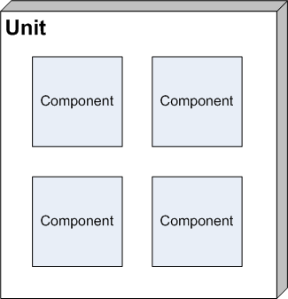
Design BeX continued
Unit
Groups components
Notes:
>> Problem description

Slide 11
Problem description
Software development phase
Design
Implementation
Problem
Implementation drifts away from design
Notes:
>> Example of problem

Slide 12

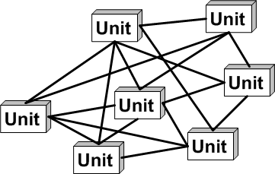
Example
BeX design specifies dependencies
Unit A allowed to depend of Unit B
Dependency
A uses functionality of B
If B changes, A might break
Notes:
>> Second problem (performance)

Slide 13
Performance
Medical sector => Quality is important
Slow system != quality
BeX requirements
Performance use cases
Not ordinary use case
No user interaction in between
Usually starts with user action
Usually end with feedback
Notes:
>> Example use case

Slide 14
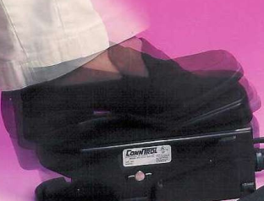
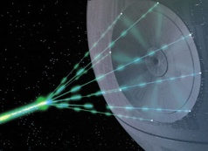
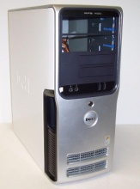

Example use case
Doctor presses pedal
X-Ray turns on
Back-end receives images
Screen shows images
Notes:
>> THE Problem

Slide 15
Problem
Use case A takes too long!
Where to look?
Use profiler
Use debug traces
Notes:
>> What are both research questions

Slide 16
Research questions
What methods for dependency checking are available for Philips?
How can we get insight in the execution and timing of a use case?
Notes:
>> Statische technique: DSM

Slide 17
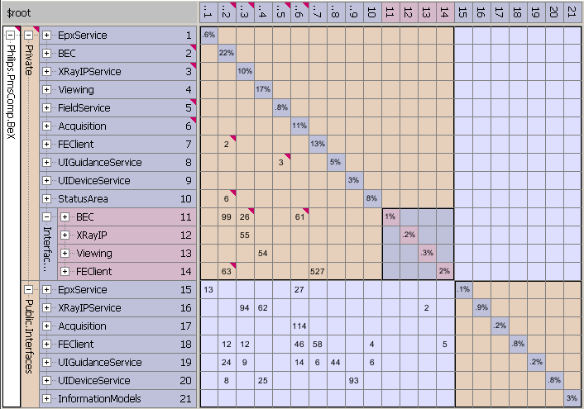
Dependency Structure Matrix
Provides
Dependency checking
Dependency weights
Easily incorporate hierarchy
Highlighting violations
Notes:
>> Rules in bex

Slide 18
Dependency rules in BeX
Between units
Through public interfaces
Between specified units
Within units
Through public or
private interfaces
Notes:
Review tools

Slide 19
Reviewed tools
NDepend
Commercial tool
.NET Reflector
Open source tool
Lattix
Commercial tool
Notes:
>>Found issues

Slide 20
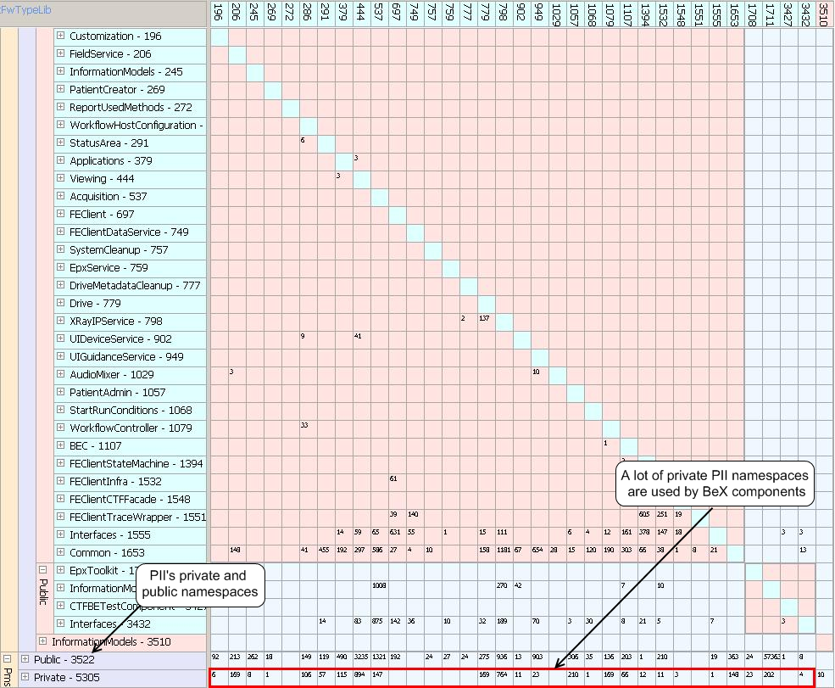
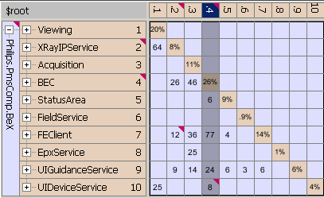
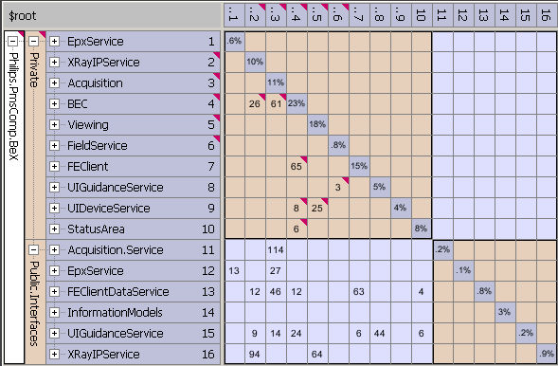
Found issues
Non specified dependencies
Dependencies through private interfaces
Direct dependencies
Dependencies on private PII interfaces
Notes:
>> Dynamic analysis

Slide 21
Dynamic analysis (recap)
How can we get insight in the execution and timing of a use case?
Problem
Profiler and debug trace are too low level
Notes:
>> cont’d

Slide 22
Dynamic analysis (recap)
How can we get insight in the execution and timing of a use case?
Sub questions
What level of detail?
How to measure?
How to visualize?
Notes:
>> 1st subQ LoD

Slide 23
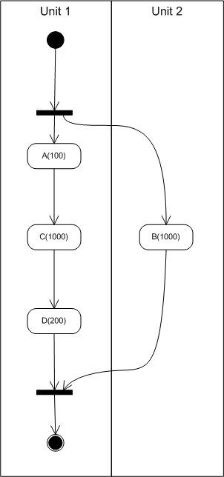
Level of detail
Activity diagrams
Specified in the design
Decomposes a use case in activities
Maps activities to units
Load patient data
Prepare image pipelines
etc.
Assigns time budgets to activities
Provides partial order
Notes:
>> Measuering data

Slide 24
Measuring the data
Existing techniques based on function traces
“Feature-level Phase Detection for Execution Trace”
(Watanabe et al)
“Locating Features in Source Code” (Eisenbarth et al)
Too invasive for timing
Notes:
>> Debug traces

Slide 25
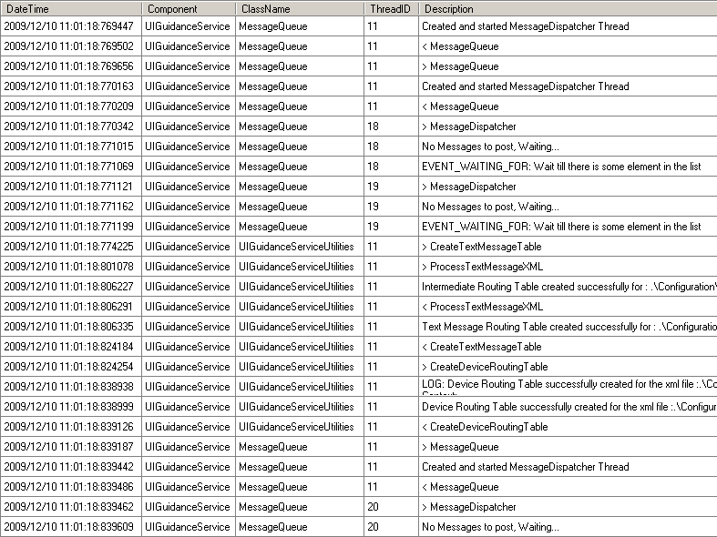
Debug traces
PII mechanism for tracing
Split up in categories
One category remains on ‘in the field’

Slide 26
Instrumentation
Manually instrument the code
Requires manual labor
Automatically interpret existing trace
Requires complex algorithm
Possibly inaccurate
Relatively small amount
of inserted traces.
Manual = feasible

Slide 27
Guidelines
Define guidelines
Used by developers
First define an activity diagram
Insert trace statements for activity

Slide 28
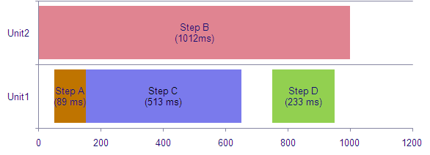
Visualization
Requirements
Show length of activities
Draw focus to problem areas
Localize problem areas

Slide 29
Verification approach
Make prototype
Apply in BeX
Gather feedback
Introduce to other business units

Slide 30
Verification results
Positive points
Problems can be localized (to units)
Easy instrumentation
Negative points
Possible to forget an activity
Difficult to distinguish
working from waiting

Slide 31
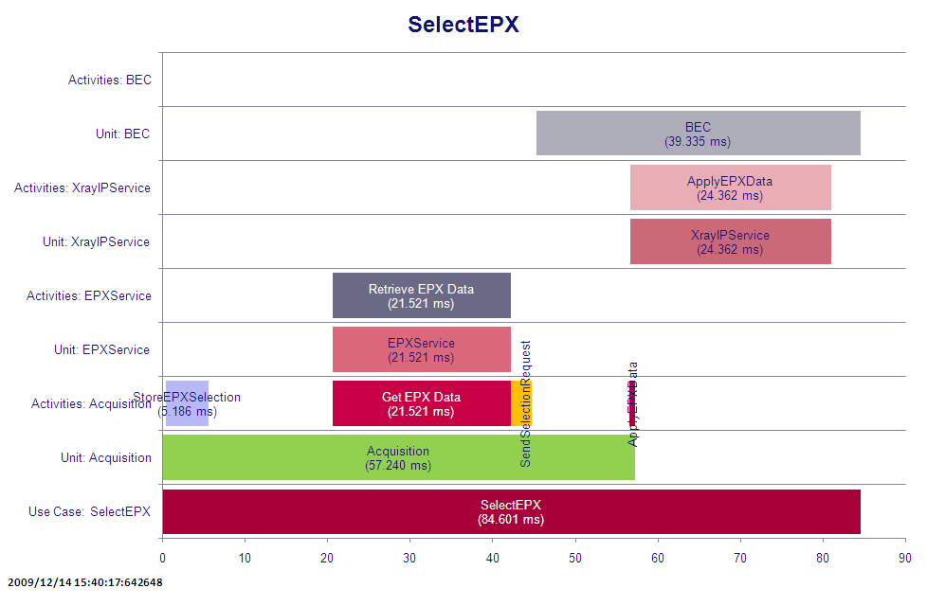
Examples
Difficulties
Unidentifiable ‘holes’
E.g. new functionality
Working or waiting?
E.g. synchronous call

Slide 32
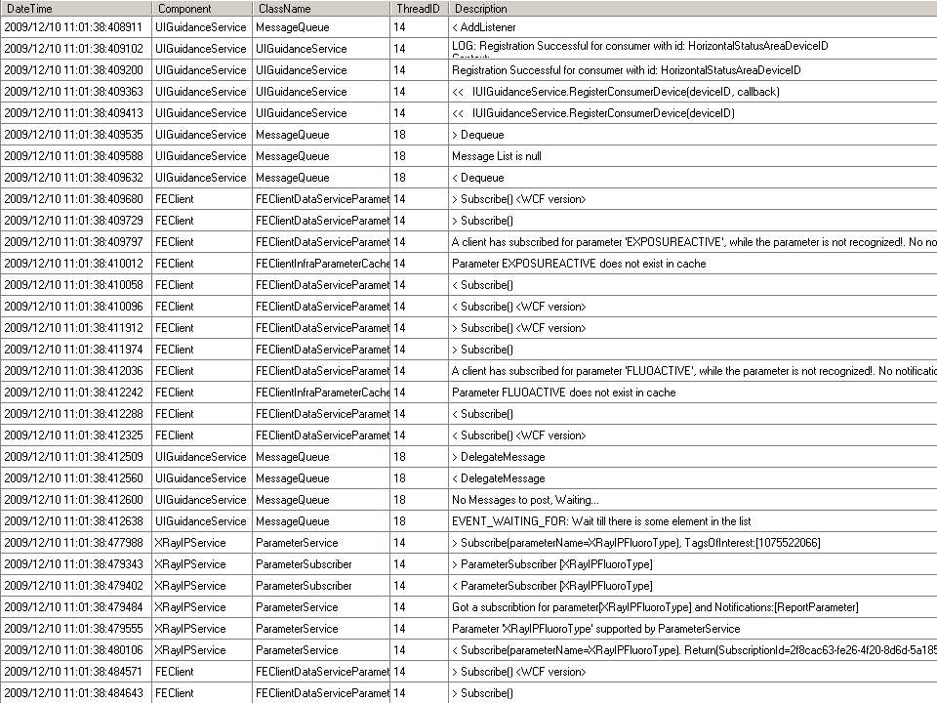
Trace counting
Count traces
Group per unit
Display per interval

Slide 33
Example

Slide 34
Example continued

Slide 35
Conclusions
Dependency checking
Custom hierarchy important
Lattix best choice
Performance analysis
Measure activities per unit
Measure manually inserted trace statements
Show in a bar diagram mapping on a time line
Add extra information to help identify errors

Slide 36
Further work
Add more info
Mix with CPU, Disc I/O
Use statistics over multiple measurements
Get averages
Find outliers
Add interactivity
Allow zooming to different levels

